Slide 1
RECURSIVE PROGRAMMING
BY GROUP 12

Slide 2
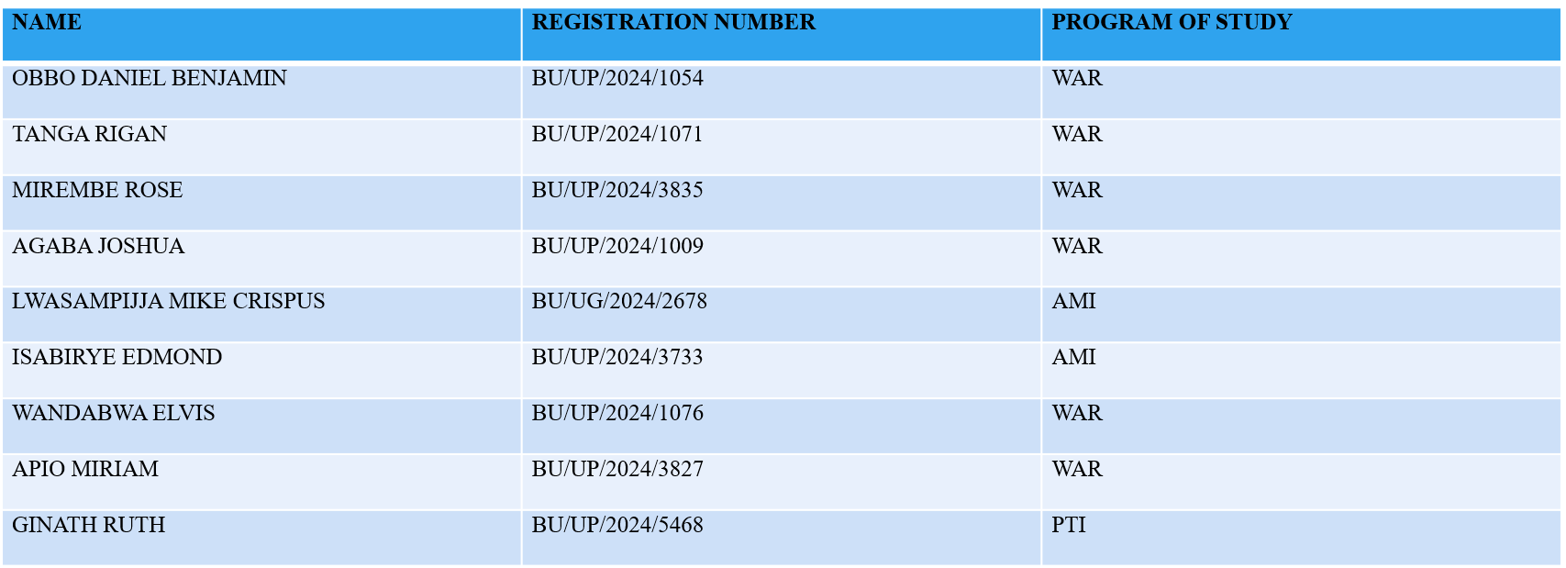
GROUP MEMBERS

Slide 3
NEWTON RASPHON METHOD USING RECURSION
function root_N=NRM_recursive(f,df,x0,tol,maxIter,iter)
if nargin<6
iter=0;
end
x1=x0-f(x0)/df(x0);% new root approximation
if abs(x1-x0)<tol % checking for convergence
root_N = x1;
return;
else
root_N=NRM_recursive(f,df,x1,tol,maxIter,iter + 1);% recursive call for the function
end
end
f=@(x)x^3-x-2;% function whose root is required
df=@(x)3*x^2-1;% derivative of the function whose root is required
x0=1.5;
tol=10^-6;% tolerance for the absolute error
maxIter=50;
iter=0:50;
root_N=NRM_recursive(f,df,x0,tol,maxIter,iter)
root_N = 1.5214

Slide 4
BISECTION METHOD USING RECURSION
function root_B=bisect_recursive(f,a,b,tol,maxiter,iter)
if nargin<6
iter=0;
end
% validate inputs
if iter>=maxiter
error('maxiter exceeded.');
end
c=(a+b)/2; % midpoint
fc=f(c);
if abs(fc)<tol || (a+b)/2<tol % base case
root_B=c;
return
end
% recursive call for the function
if f(a)*f(c)<0
root_B=bisect_recursive(f,a,c,tol,maxiter,iter+1);
else
root_B=bisect_recursive(f,c,b,tol,maxiter,iter+1);
end
end
f=@(x)x^3-x-2;
a=1;
b=2;
tol=10^-6;
maxiter=50;
iter=0:50;
root_B=bisect_recursive(f,a,b,tol,maxiter,iter);
fprintf("root_B = %0.4f\n",root_B);
root_B = 1.5214

Slide 5
SECANT METHOD
function root_S=secant_recusive(f,x0,x1,tol,maxiter,iter)
if nargin<6
iter=0;
end
f0=f(x0);
f1=f(x1);
if abs(f1-f0)==0 % validate inputs
error('denominator is zero.');
end
x2=x1-f1*((x1-x0)/(f1-f0)); % new root
if abs(x2-x1)<tol % base case
root_S=x2;
return
end
root_S=secant_recusive(f,x1,x2,tol,maxiter,iter+1); % recursive call for the function
end
f=@(x)x^3-x-2;
x0=1;
x1=2;
tol=10^-6;
maxiter=50;
iter=0:50;
root_S=secant_recusive(f,x0,x1,tol,maxiter,iter);
fprintf("root_S = %0.4f\n",root_S);
root_S = 1.5214

Slide 6
FIXED ITERATION METHOD USING RECURSION
function root_F=fixediter_recursive(g,x0,tol,toc,maxiter,iter)
tic;
if nargin<6
iter=0;
end
x1=g(x0); % new root
if abs(x1-x0)<tol % base case
root_F=x1;
return
end
root_F=fixediter_recursive(g,x1,tol,toc,maxiter,iter+1); % recursive call
end
g=@(x)(x+2).^(1/3);
x0=1.5;
tol=10^-6;
maxiter=50;
iter=0:50;
root_F=fixediter_recursive(g,x0,tol,toc,maxiter,iter)
root_F = 1.5214

Slide 7
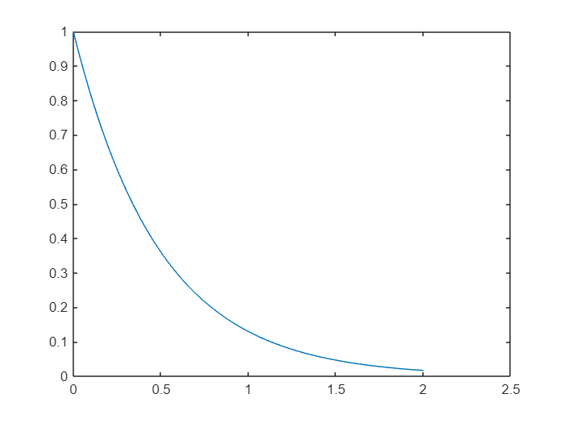
SOLVING ODEs USING RECURSION
EULER'S METHOD
function [T,Y] = euler_recursive(f, t0, tN, y0, N)
% f: function handle f(t,y)
% t0,tN: time interval
% y0: initial value (scalar or column vector)
% N: number of steps
h = (tN - t0)/N;
T = zeros(N+1,1);
Y = zeros(numel(y0), N+1);
T(1) = t0;
Y(:,1) = y0;
% recursive helper
function step(k)
if k > N, return; end
t = T(k);
y = Y(:,k);
ynext = y + h * f(t,y);
T(k+1) = t + h;
Y(:,k+1) = ynext;
step(k+1);
end
step(1);
end
f = @(t,y) -2*y;
[T,Y] = euler_recursive(f, 0, 2, 1, 100);
plot(T, Y)

Slide 8
SOLVING ODEs USING RECURSION
EULER'S METHOD
function [T,Y] = euler_recursive(f, t0, tN, y0, N)
% f: function handle f(t,y)
% t0,tN: time interval
% y0: initial value (scalar or column vector)
% N: number of steps
h = (tN - t0)/N;
T = zeros(N+1,1);
Y = zeros(numel(y0), N+1);
T(1) = t0;
Y(:,1) = y0;
% recursive helper
function step(k)
if k > N, return; end
t = T(k);
y = Y(:,k);
ynext = y + h * f(t,y);
T(k+1) = t + h;
Y(:,k+1) = ynext;
step(k+1);
end
step(1);
end
f = @(t,y) -2*y;
[T,Y] = euler_recursive(f, 0, 2, 1, 100);
plot(T, Y)

Slide 9
FIBONACCI PROBLEM BY RECUSIVE
function g=fibonacci_recursive(n)
% base case
if n==0
g=0;
%Base case
elseif n==1
g=1;
else
g=fibonacci_recursive(n-1)+fibonacci_recursive(n-2); % recursive call
end
end
n=25;
g=fibonacci_recursive(n);
fprintf('value of g is %d',g)
value of g is 75025

Slide 10
FIBONACCI PROBLEM BY DYNAMIC PROGRAMMING
function f=fibonacci_DP(n)
% base case
if n==0
f=0;
return;
end
% DP table
T=zeros(1,n+1);
T(1)=0;
T(2)=1;
for k=3:n+1
T(k)=T(k-1) + T(k-2);
end
f=T(n+1);
end
n=25;
f=fibonacci_DP(n);
fprintf("result of f = %d\n",f);
result of f = 75025

Slide 11
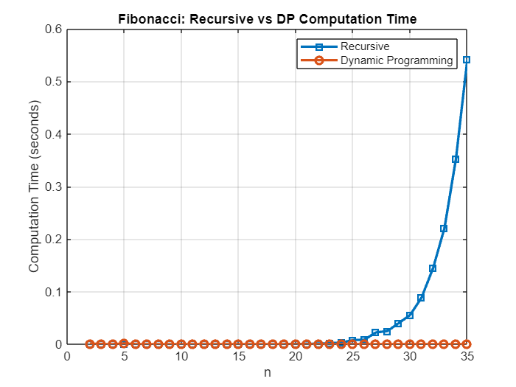
GRAPHICAL COMPARISON BETWEEN RECURSIVE AND DYNAMIC PROGRAMMING FOR FIBONACCI PROBLEM
max_n = 25;
rec_time = zeros(1, max_n);
dp_time = zeros(1, max_n);
for n = 2:max_n
tic;
fibonacci_recursive(n);
rec_time(n) = toc;
tic;
fibonacci_DP(n);
dp_time(n) = toc;
end
figure;
plot(2:max_n, rec_time(2:end), '-s', 'LineWidth', 2);
hold on;
plot(2:max_n, dp_time(2:end), '-o', 'LineWidth', 2);
xlabel('n');
ylabel('Computation Time (seconds)');
legend('Recursive', 'Dynamic Programming');
title('Fibonacci: Recursive vs DP Computation Time');
grid on;

Slide 12
KNAPSACKER PROBLEM BY RECURSION
function maxvalue=knapsack_recursive(weights,values,capacity,n) %wrapper function to recall the recursive helper
% base case, that is no item or no capacity left
if n==0||capacity==0
maxvalue=0;
return;
end
% if weight of nth item is more than capacity then skip it
if weights(n)>capacity
maxvalue=knapsack_recursive(weights,values,capacity,n-1);
else
% inlude or exclude the nth item
include=values(n)+knapsack_recursive(weights,values,capacity-weights(n),n-1);
exclude =knapsack_recursive(weights,values,capacity,n-1);
maxvalue=max(include,exclude);
end
end
weights=[95,64,23,73,50,22,6,57,40,98];
values=[89,59,23,43,100,72,44,12,7,64];
capacity=300;
n=length(weights);
maxvalue=knapsack_recursive(weights,values,capacity,n);
fprintf("maximum value is %d\n",maxvalue);
maximum value is 394

Slide 13
KNAPSACK PROBLEM BY DYNAMIC PROGRAMMING (DP)
function maxVal = knapsack_DP(W, weights, values)
n=length(values);
K = zeros(n+1, W+1); % DP table
for i = 1:n+1
for w = 1:W+1
if i == 1 || w == 1
K(i, w) = 0;
elseif weights(i-1) <= (w-1)
K(i, w) = max(values(i-1) + K(i-1, w-weights(i-1)), K(i-1, w));
else
K(i, w) = K(i-1, w);
end
end
end
maxVal = K(n+1, W+1);
end
weights=[95,64,23,73,50,22,6,57,40,98];
values=[89,59,23,43,100,72,44,12,7,64];
W=300;
maxVal=knapsack_DP(W,weights,values);
fprintf("maximum value is %d\n",maxVal);
maximum value is 394

Slide 14
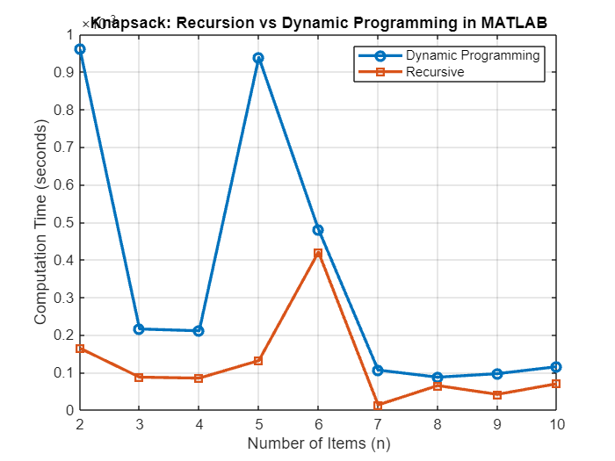
GRAPH FOR TIME COMPARISON (RECURSIVE VS DYNAMIC PROGRAMMING)
max_n = 10;
dp_time = zeros(1, max_n);
rec_time = zeros(1, max_n);
for n = 2:max_n
tic;
knapsack_DP(W, weights(1:n), values(1:n));
dp_time(n) = toc;
tic;
knapsack_recursive(weights(1:n), values(1:n),capacity, n);
rec_time(n) = toc;
end
figure;
plot(2:max_n, dp_time(2:end), '-o', 'LineWidth', 2);
hold on;
plot(2:max_n, rec_time(2:end), '-s', 'LineWidth', 2);
xlabel('Number of Items (n)');
ylabel('Computation Time (seconds)');
legend('Dynamic Programming', 'Recursive');
title('Knapsack: Recursion vs Dynamic Programming in MATLAB');
grid on;

